Slide 1
Chess - Game
Veljko Deljanin Aleksandar Ilić
Petar Pavlović

Slide 2
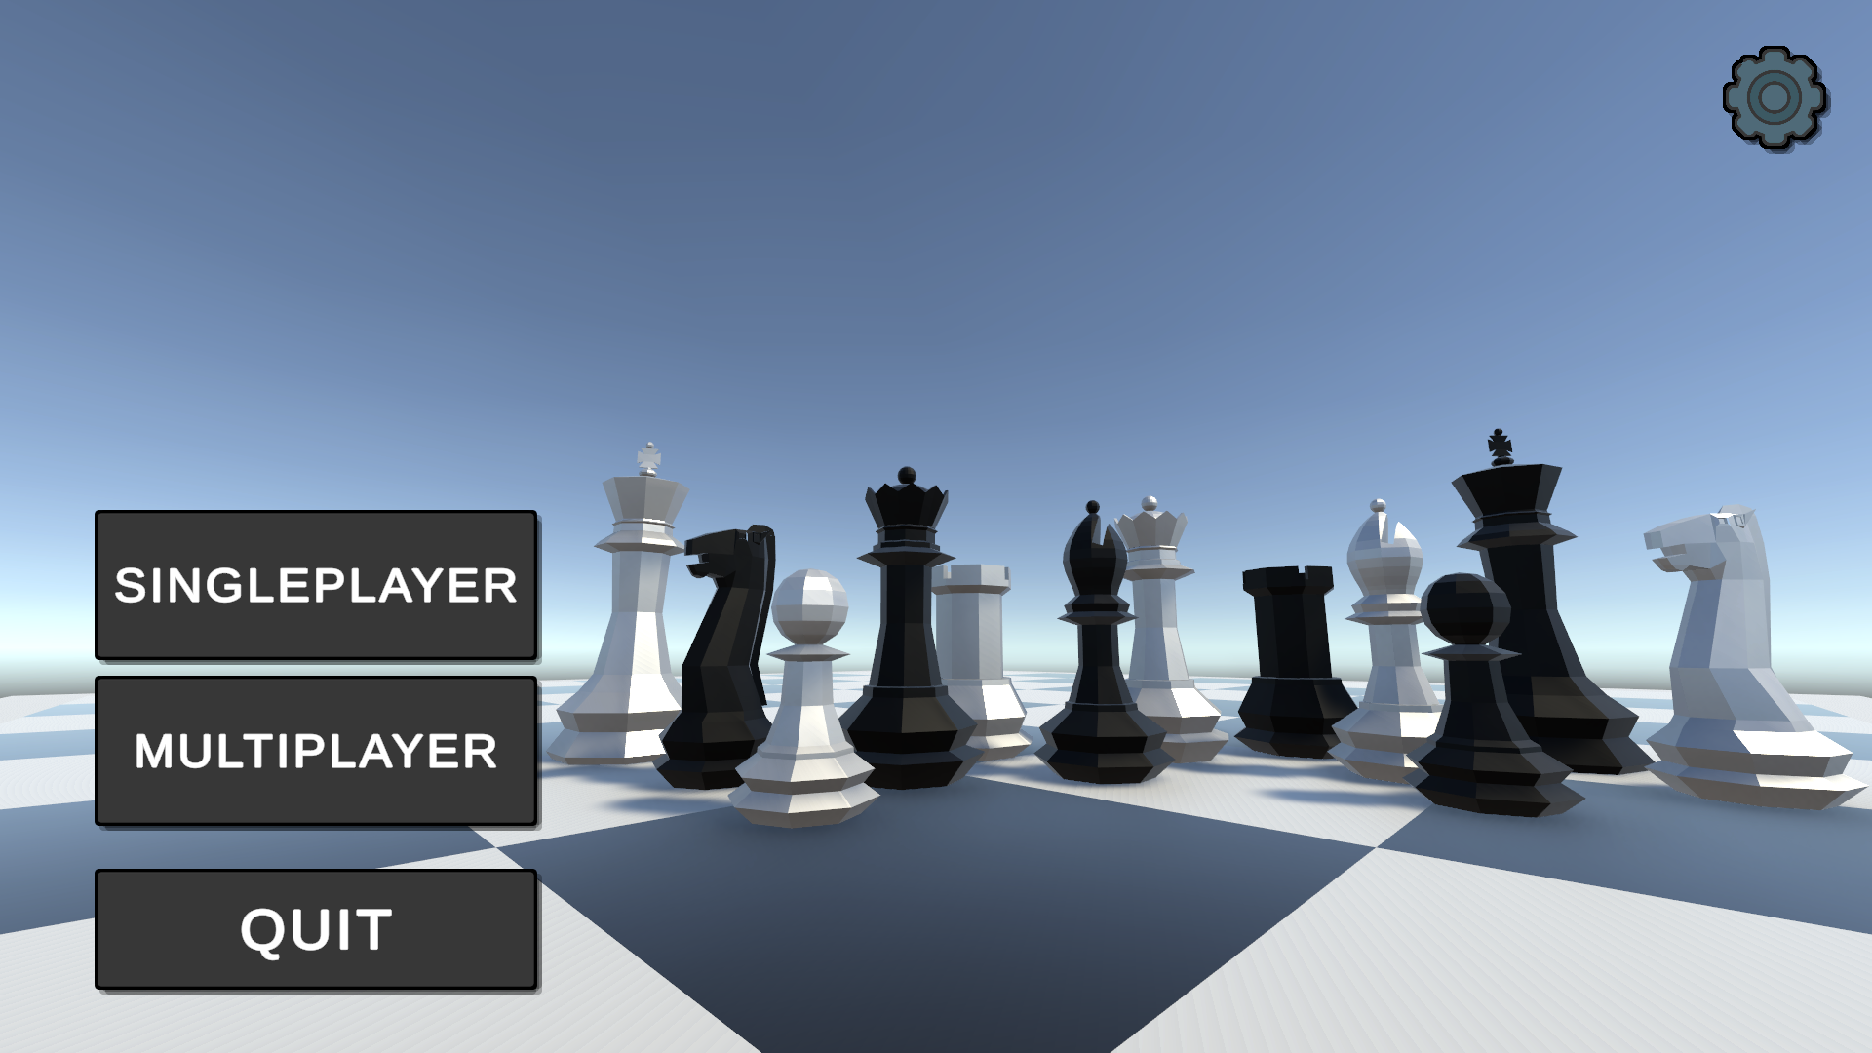
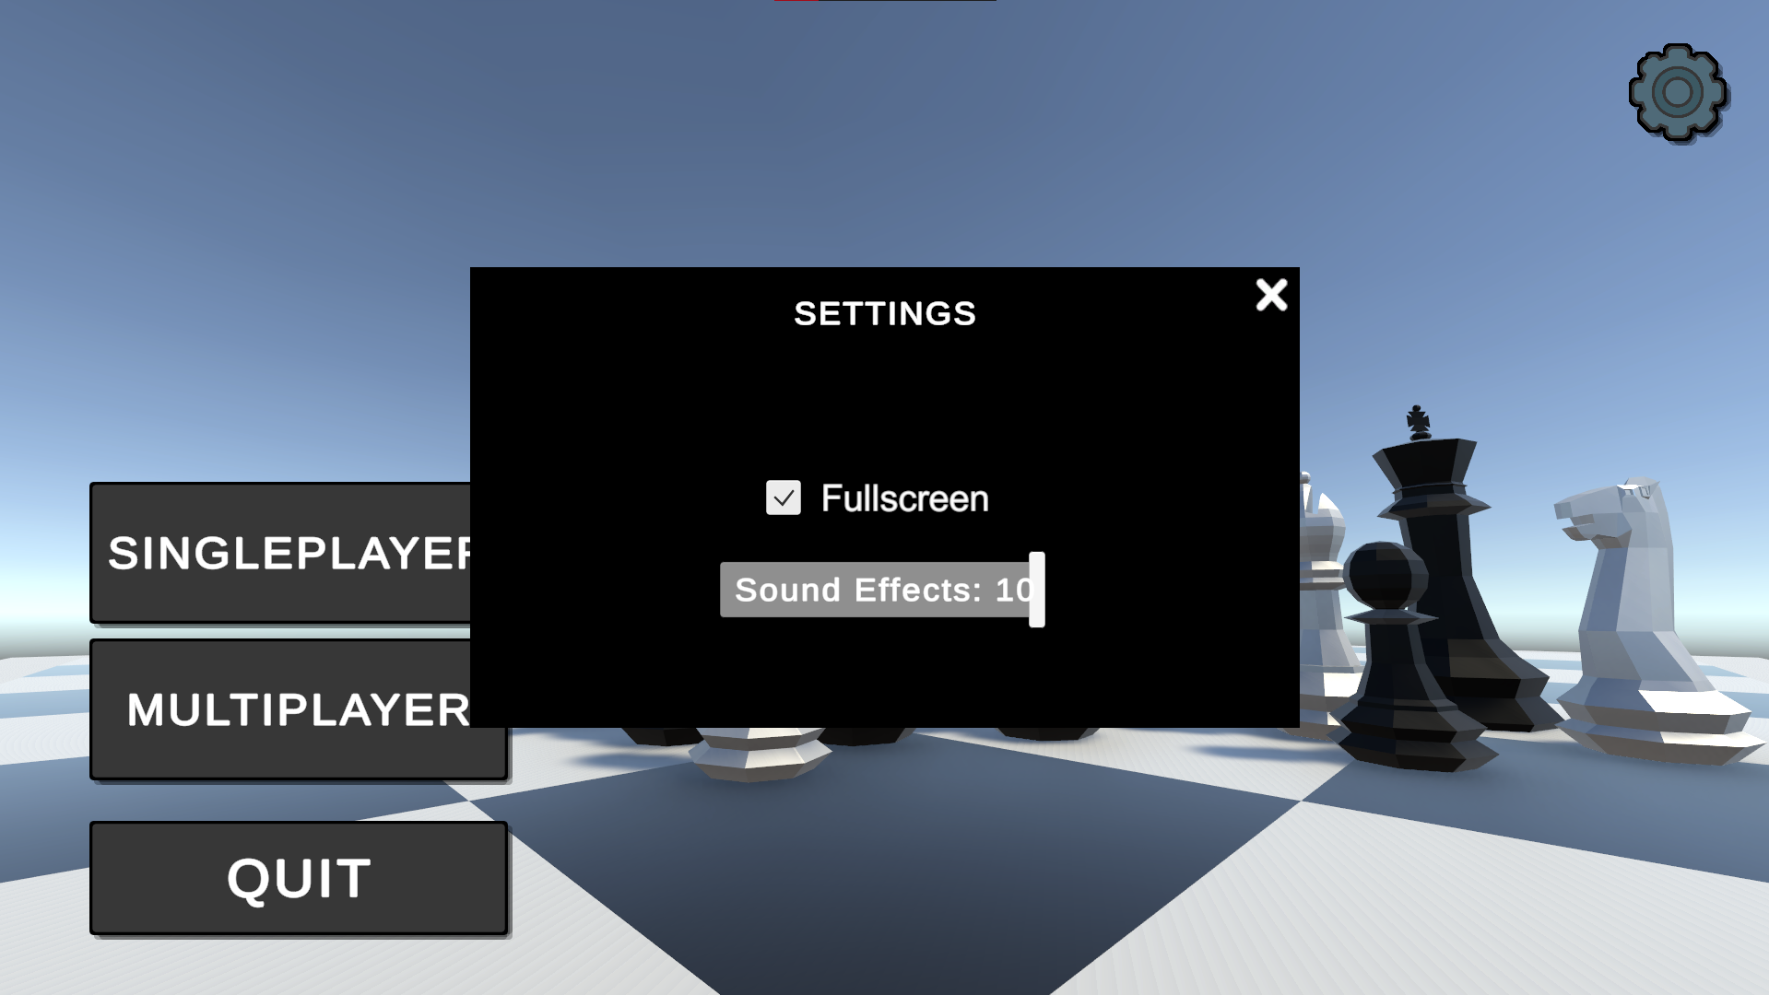
Main menu:
~Singleplayer
~Multiplayer
~Settings

Slide 3
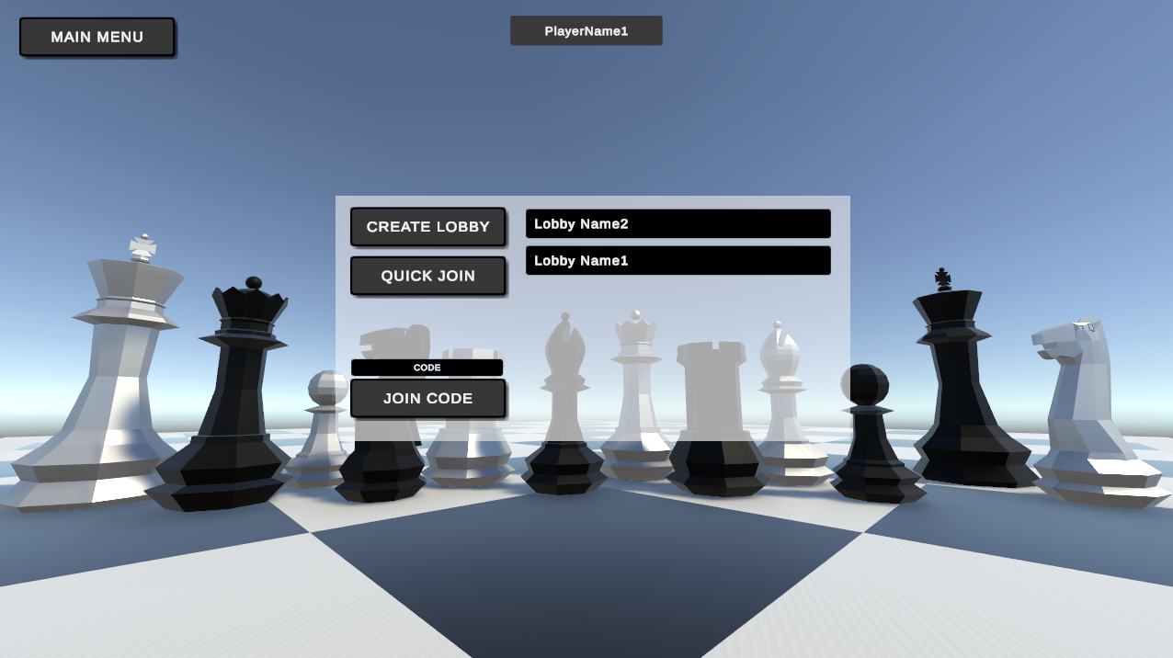
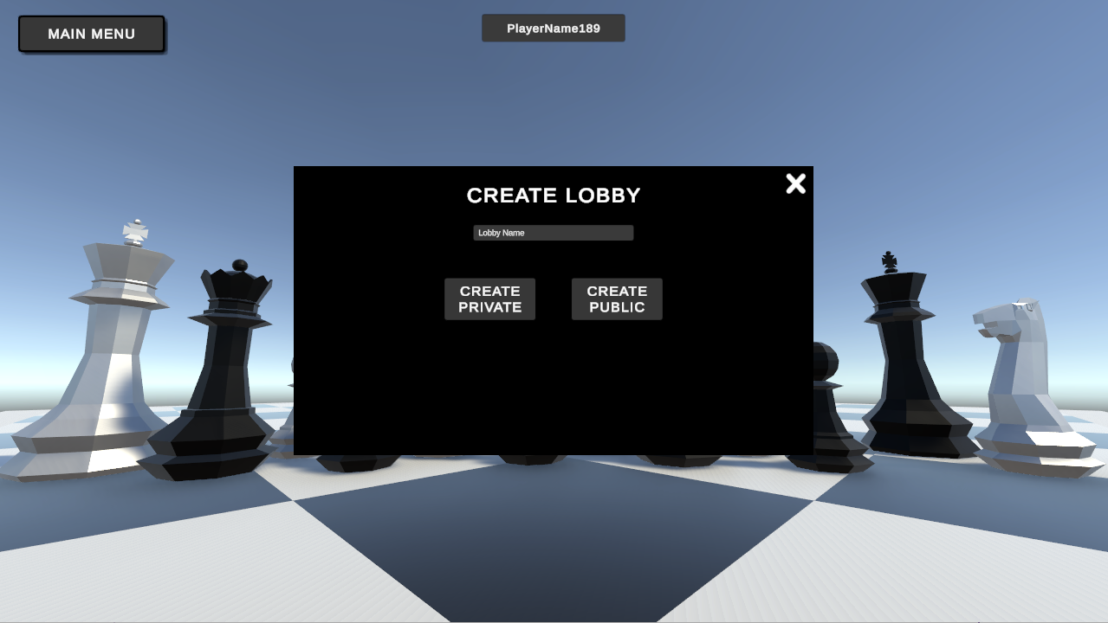
~Player name
Multiplayer:
~Create lobby
~Join via code
~Quick join

Slide 4
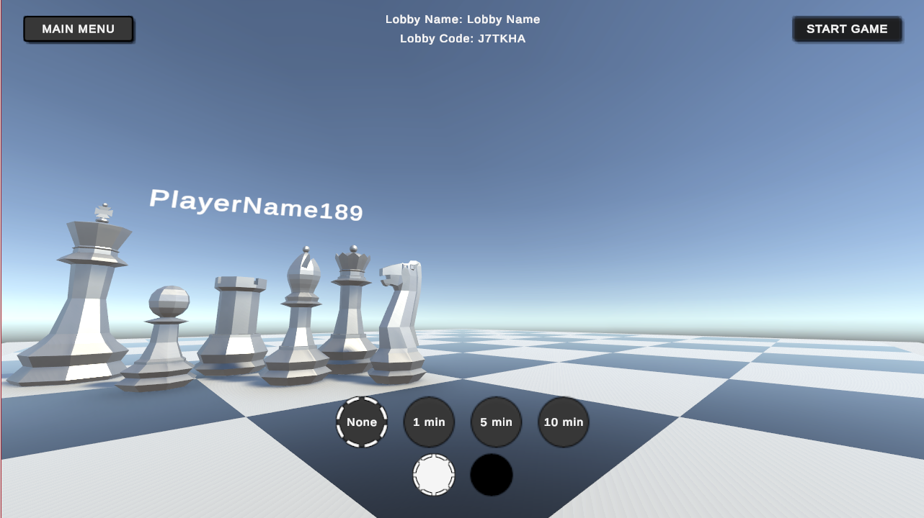
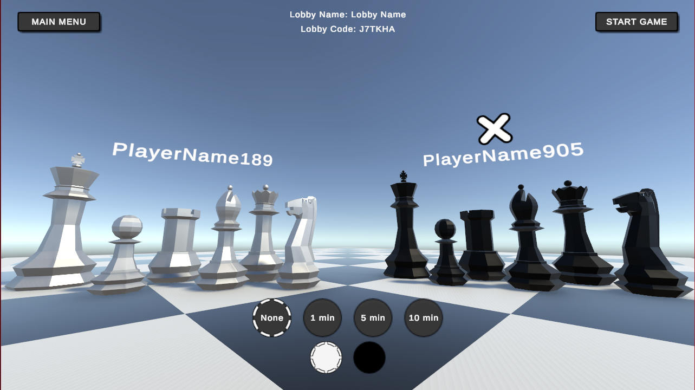
~Color
Multiplayer:
~Kick
~Start
~Lobby name
and code
~Time

Slide 5
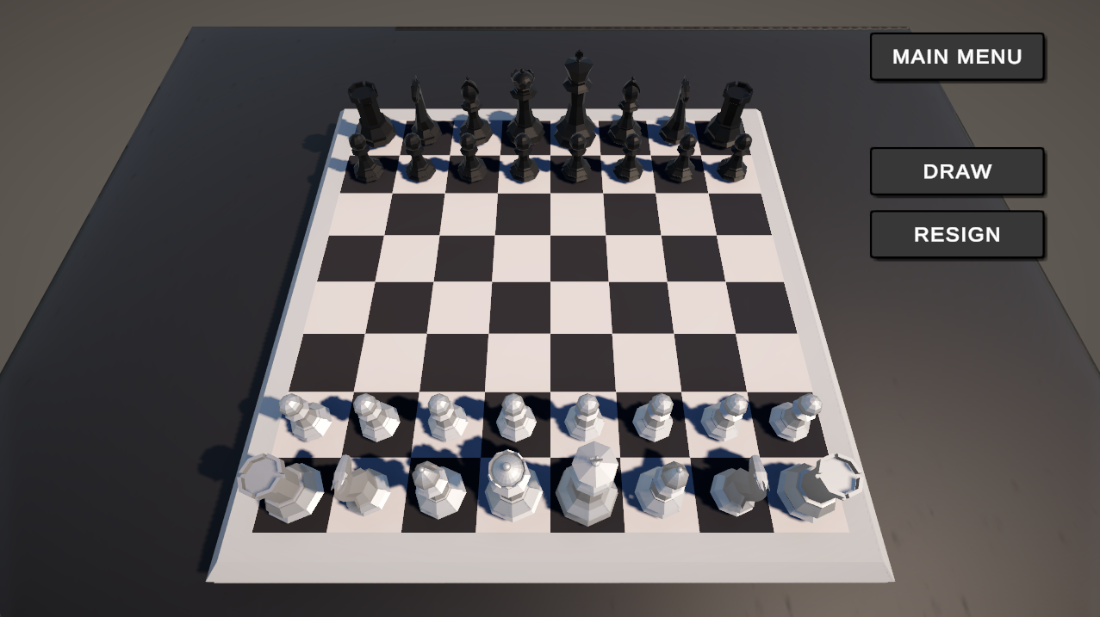
~Draw?
In game:
~Resign?

Slide 6
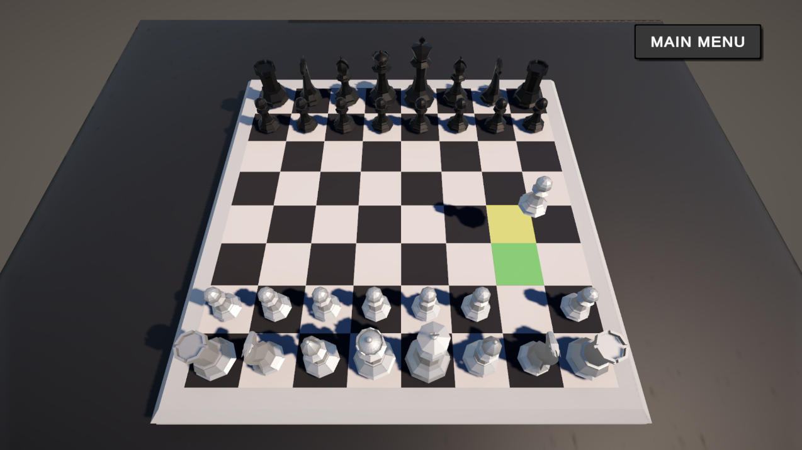
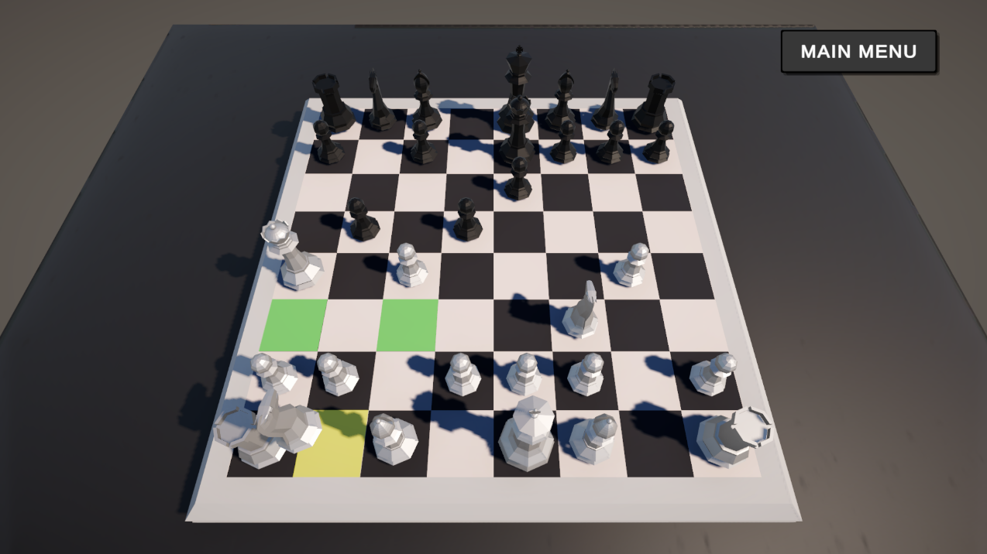
Basics:
~With two clicks
~Make your move

Slide 7
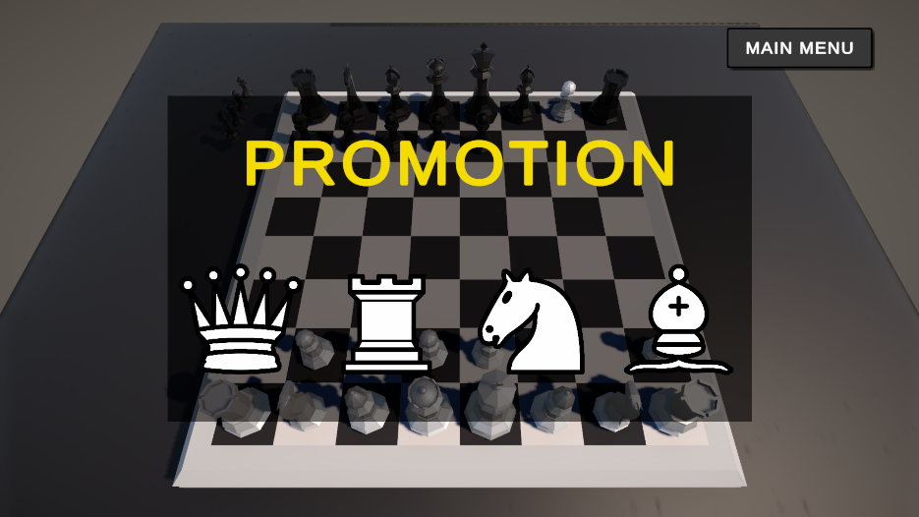
Basics:
~En passant
~Promotion

Slide 8
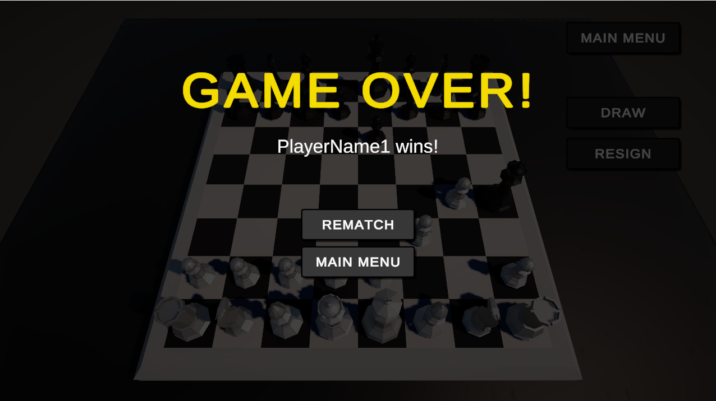
Game over:
~Checkmate

Slide 9
Want to play
a game?

